Slide 1
Introduction to the
OnDemand Toolbox
General Application Developer Overview

Slide 2
OnDemand Toolbox Overview
The modules of the Toolbox

Slide 3




OD Toolbox Components
OD Update
Update key-fields of documents in the OnDemand
OD Delete
Delete Documents from the OnDemand
OD Store
Archive Files directly into OnDemand
OD Filesystem Monitor
Monitors directories and automatically archives files using
preconfigured field-information and file types

Slide 4


OnDemand Client - ARSGUI
OD Client
ARSOLE.ocx
Used by this Toolbox
COM/OLE Component
Most functions .NET compatible
OLE
DDE
Not used by this Toolbox
Depreciated in WinXP / Future Windows versions
VB6 compatible

Slide 5

General ARS/OnDemand Application Architecture
.NET Applications:
OD Update
OD Delete
OD Store
OD Filesystem Monitor
OD Client
OLE
DDE
VB6 Applications:
ARS Helper Libary

Slide 6
Coding languages and architecture
What is .NET and what does the application consist of?

Slide 7




What is .NET?
VB.net, C#, ...
Sourcecode
Multiple Languages:
VB.net, C#, Delphi.net, …
Fully object orientated languages
Abstract architecture
Just-In-Time Compiling
Framework Runtime like Java
Managed Code – Supervision by the .net Runtime
Compiler
EXE file
MSIL code
Runtime
JIT-Compiler
.NET Runtime Environment
native machine code

Slide 8

Why a additional VB6 dynamic library?
Loose interface definition of the ARSOLE component
Strict and managed (supervised) interface routines in .NET
Loose interface routines in VB 6
OLE is a native VB6 technology
Some specific routines of the ARSOLE cannot be called from .net
ARSOLE.ocx
VB6 DLL
Passes ARS
interface
.net
Application
.net
Application

Slide 9
What does the VB6 DLL do?
ARSOLE.ocx
VB6 DLL
.net Application
GetNumFolder
GetFolderName
GetFolders
OpenDoc
StoreDoc
DeleteDoc
…
GetNumFolder
GetFolderName
GetFolders
Folders
.net Application
uses the interface
of the VB6 DLL to
access the methods
of the ARS Control.
OpenDoc
StoreDoc
DeleteDoc
…
The VB6 DLL provides the same interface like the ARS control.
It passes the calls from the .net applications to the ARS control.

Slide 10
General architecture of a .net windows application
Everything is a class!
Object orientated
All functionality is encapsulated in classes
A class represents a bunch of functions and properties for
a specific function
A window is a class with a graphical context

Slide 11
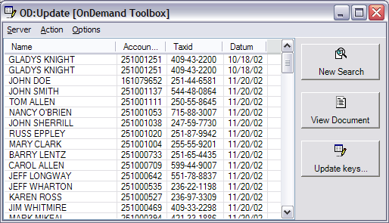
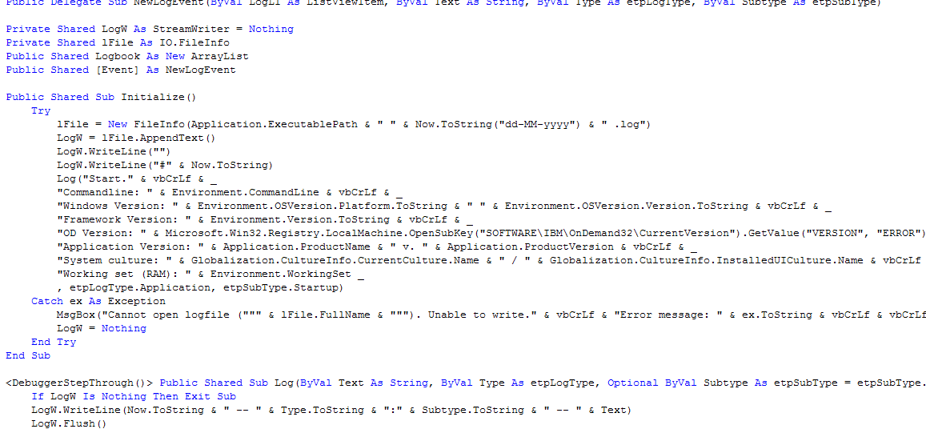

General architecture of a .net windows application
Windows.Forms
Visible dialogs
Application’s user interface
A class which inherits
System.Windows.Forms.Form
UI-less Classes
No graphical elements
Each class capsules a specific
function or part of the application

Slide 12

Each toolbox application consists of…
Windows.Forms.Form Classes – Dialogs
  A main dialog
Core function classes
  The core functionality may be implemented directly in the class of the main form (OD Update, OD Delete)
Helper Classes
  Logger, Custom Controls, Enumerations
Helper classes can be shared by more than one application

Slide 13
Architectural overview
Application architecture of OD Update (and OD Delete)

Slide 14

OD Update | OD Delete – Key points
Similar Interface OD Update – OD Delete
Extra tool for each function
Interface:
  Login
  Select Folder
  Enter Search Criteria
  View Document list
  View document
  Update / Delete document

Slide 15
OD Update / OD Delete: User action path
Delete documents
Login
Update documents
View document hitlist
Select a folder
View documents
Enter search criteria

Slide 16
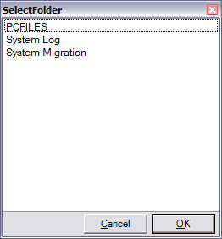
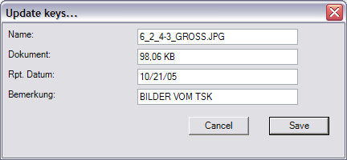
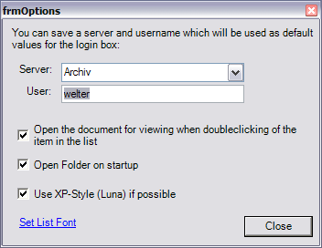
Class architecture – OD Update
Windows.Forms
Other Classes
SelectFolder
  Displays availible folders
  opens selected folder
MainForm
  Search panel, document list and document viewer
frmUpdate
  Update-functionality
frmOptions
Logger
  Log-functionality
Enumerations
  Text-representations of all return codes for ARS commands
SearchControl
  Usercontrol; represents a search-field for the search-panel (MainForm)
* Shared

Slide 17
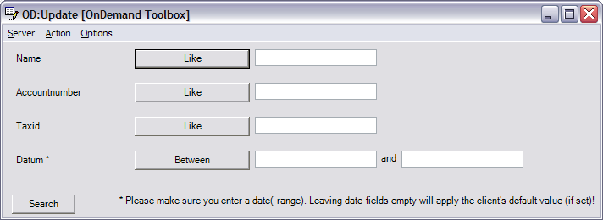
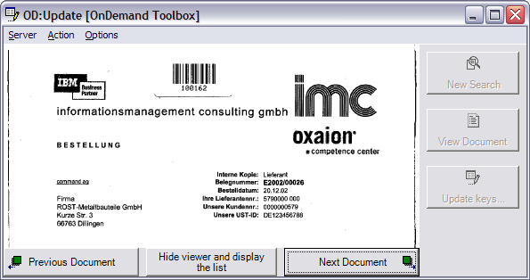
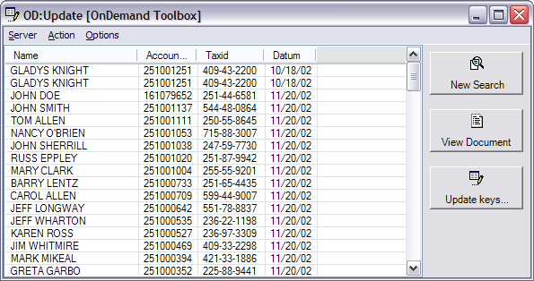
Class architecture – OD Update - Mainform
Mainform
A list of all searchable fields of a folder. User enters search criteria and starts search
Multiple UIs
A viewer control
A list of all documents found. View/Update buttons

Slide 18
OD Update and OD Delete – Similarities
Common Mainform
SelectFolder-Dialog, Controls, miscellaneous classes shared
Identical design - Nearly same code
Only difference: actual functionality
Update dialog
Delete function

Slide 19
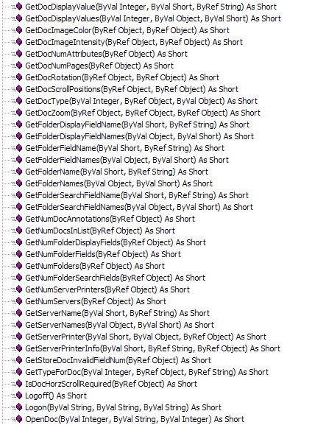
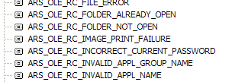
Communication with the ARSOLE Control
ARSOLE control provides various methods to access functions of the OnDemand system
The control provides a graphical part in which opened documents are displayed
Each function returns a numeric response code
X=ARSOLE.Logon(“localhost”, “usr1”, “secret”)

Slide 20





OD Update & OD Delete – Communication Model
Mainform
Login
GetFolderSearchFields
SetSearchFieldData
Clear
SelectFolder
SetSearchFieldData
Search
GetFolders
GetFolderDisplayFields
OpenFolder
GetDocumentValue
GetDocType
OpenDoc
CloseDoc

Slide 21

OD Update – specific update functionality
Update
Mainform
GetFolderSearchFields
GetFolderDisplayFields
SetSearch
FieldData
Clear
GetDocumentValue
SetSearchFieldData
Search
GetFolderDisplayFields
UpdateDoc
GetDocumentValue
GetDocType
OpenDoc
CloseDoc
Display values, update
Return to Mainform; Restart search

Slide 22
OD Delete – specific delete functionality
Mainform
DeleteDoc
GetFolderSearchFields
SetSearchFieldData
Clear
SetSearchFieldData
Search
Delete document and
restart search
GetFolderDisplayFields
GetDocumentValue
GetDocType
OpenDoc
CloseDoc

Slide 23


IO-Interaction – OD Update & OD Delete
Logger
  Shared class. Used to log all activities of the application.
  Date, Type, Subtype, Logtext
Configuration  Registry
  Server, Username, Windowsize, … are saved in the Windows Registry
    HKEY_CURRENT_USER\Software\IBM\OnDemand Toolbox
    HKEY_CURRENT_USER\Software\IBM\OnDemand Toolbox\Updater

Slide 24
Architectural Overview – OD Store
The OD Store component

Slide 25
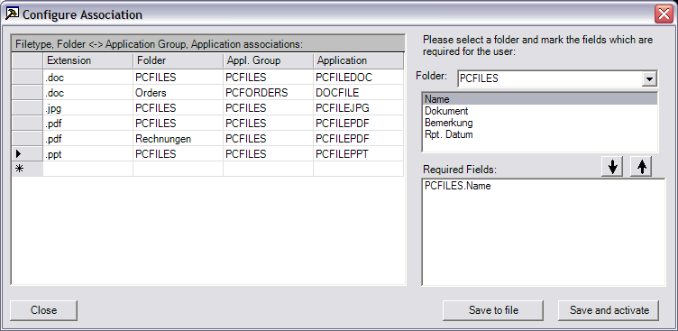
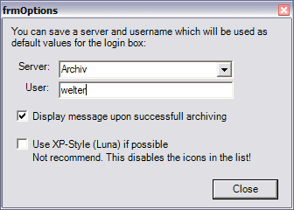
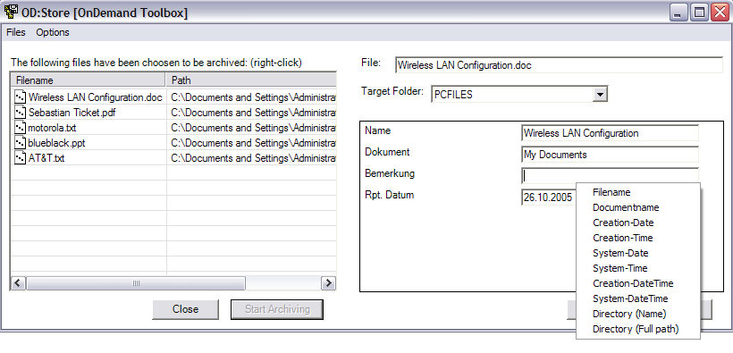
Class architecture – OD Store
Windows.Forms
Other Classes
MainForm
  File list, value input and archiving action
frmConfigure
  Configure the possible file-types and applications
frmOptions
Logger
  Log-functionality
Enumerations
  Text-representations of all return codes for ARS commands
FileDocument
  Core function class
  Handles a file
* Shared

Slide 26
OD Store - Configuration
Choose a folder and select one or more fields to move them to the list below. All fields in the list below will be marked as mandatory fields. The user will have to enter a value for this field.
Enter the associations here.
Only file types / folders configured here
can be archived using OD Store
Save the configuration as .reg-file
Easy export; does not activate on
current computer
Saves the configuration to the local
computer’s registry.
Activates the configuration

Slide 27
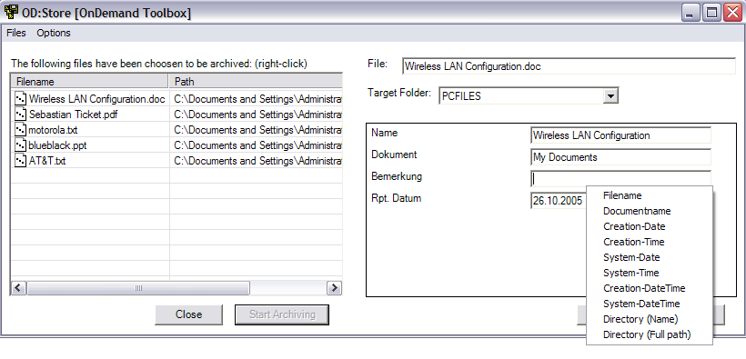
OD Store – User action path
Right click to add files to the
list. These files will be archived.
Select the folder and
enter the values.
By right-clicking on a textbox a drop-down
menu appears. Select a index from the list.
Your selection will be maintained through all files

Slide 28
OD Store – Communication Model
Mainform
Login
Allow to add
files to list
Start Archiving
Config
check
GetFolders
GetFolderDisplayFields
StoreDoc

Slide 29
OD Filesystem Monitor
Architectural overview

Slide 30
OD Filesystem Monitor – Architectural key points
Configuration stored in XML file
Multiple directories recursively monitored
Multiple Filetype ↔ Application ↔ Appl. Group associations
Configurable file-handling after archive
(delete, move, ignore, …)
Success and Error target directories when moving
Multi-threaded architecture
Intensive activity log

Slide 31


OD Filesystem Monitor – Monitoring engine
2 parallel
engines
FilesystemWatcher
Manual Walk
Manual Walk through all
directories
Initiated regularly (5 min)
Able to cope with huge
amount of files
Huge CPU and HD load
Automatic Observation
of directories
Provides by .NET Framework
and Windows Shell
No CPU load during idle times
Unable to track massive
changes
100% Reliability
Resource efficiency

Slide 32
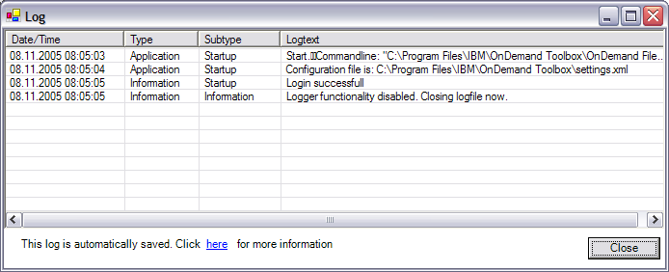
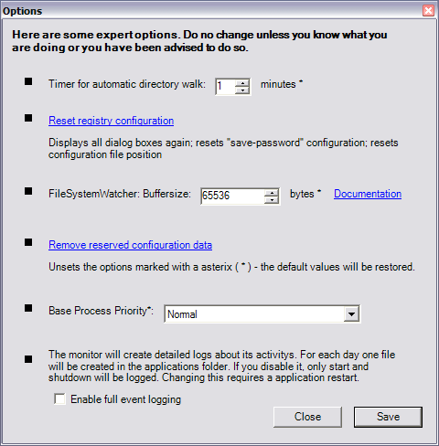
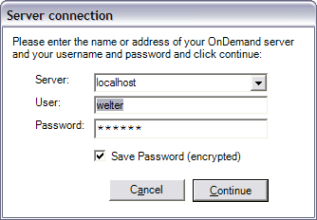
Class architecture
Windows.Forms
Other Classes
frmLogin
  Own login dialog box. We need to save the password so the Client’s logon cannot be used here
Mainform
  Configure the monitor
frmOptions
  Advanced options
frmLog
  Log viewer
Monitor
  Core function class
Logger
  Log-functionality
Enumerations
  Text-representations of all return codes for ARS commands
Settings
  All configuration of the monitor is saved in a XML file
Encryption, DelayWalker, …
* Shared

Slide 33

IO-Interaction
Logger
  Shared class. Used to log all activities of the application.
  Date, Type, Subtype, Logtext
Configuration  XML file
  All configuration data is stored in XML.
  The configuration file remains on the computer even after uninstall
  The configuration can be exported and imported

Slide 34
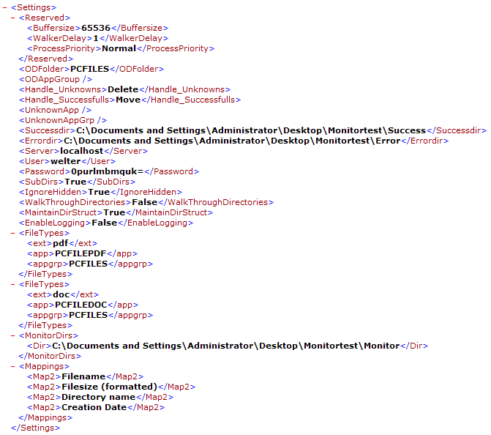
XML
This is an example
Settings.xml configuration
file of the OnDemand Monitor

Slide 35
Regular Expression
New feature in version 2.0
Able to use regular expressions on…
  Filename
  Complete path
… to extract information which can be used as index information
Edit the expression directly or…
Use a regex Wizard which helps extracting separated parts of a filename

Slide 36
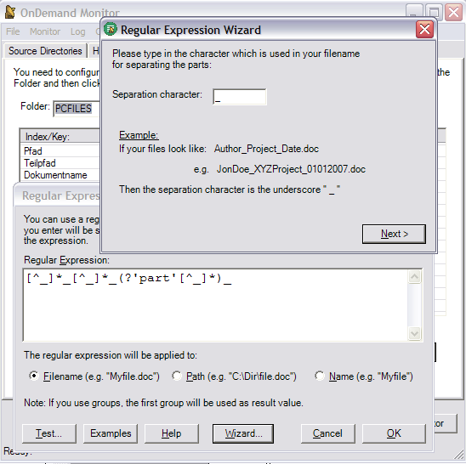
Regular Expression
Wizard
Editor

Slide 37
OD Migration
Import, Export and DirectMigration

Slide 38
Three tools
OD Export
  Export data to local PC
OD Import
  Import previously exported data
OD DirectMigration
  Both functions in one tool. Export → Import

Slide 39
Highlights
Export all AnyStore documents to local PCs
Metadata available as XML file
Migration within different OnDemand versions
  Even RDARS! – Everything that is accessible through the standard windows client, can be used
Exported data can be used for other purposes/applications
DirectMigration offers a fire-and-forget solution for migration / copy of all AnyStore documents

Slide 40
OD Export
OD Export
  Mass export of objects to local harddisc
  Only AnyStore documents / Multiplatform formats
    Unable to export resources and overlays
  Exports…
    …raw object (each object into a file)
    …a XML file containing the metadata (the keys)
  The XML metadata catalogue links the metadata to the files
  A small tool in available (“ExportsLookup”) for a very basic sort of searching and browsing through the exported files

Slide 41
OD Import
Imports objects (files and metadata)
  Objects need to be exported using the OD Export tool before
  Metadata is being read out of the XML metadata catalogue which is generated by the OD Export tool
  Flexible mapping between the exported keys and the keys of the folder to import into

Slide 42
OD DirectMigration
DirectMigration = Export + Import
  Logon on two OnDemand instances at once
  Select a hitlist on the ‘source’ OnDemand
  Map source-folder-fields to target-folder-fields
Detailed logs
Enables to migrate mass amounts of objects

